Slide 1
[DesirMED] - WP4 - Cross update T4.1 and T4.2
Updated on 19.12.2024 by Vuong Pham

Slide 2
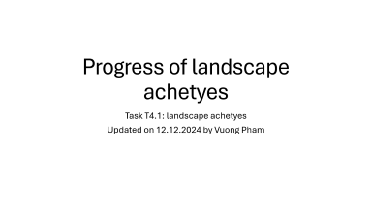
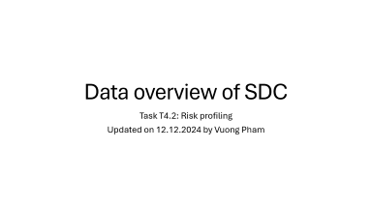
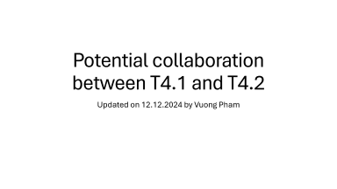
Table of content

Slide 3
Data overview of SDC
Task T4.2: Risk profiling
Updated on 12.12.2024 by Vuong Pham

Slide 4
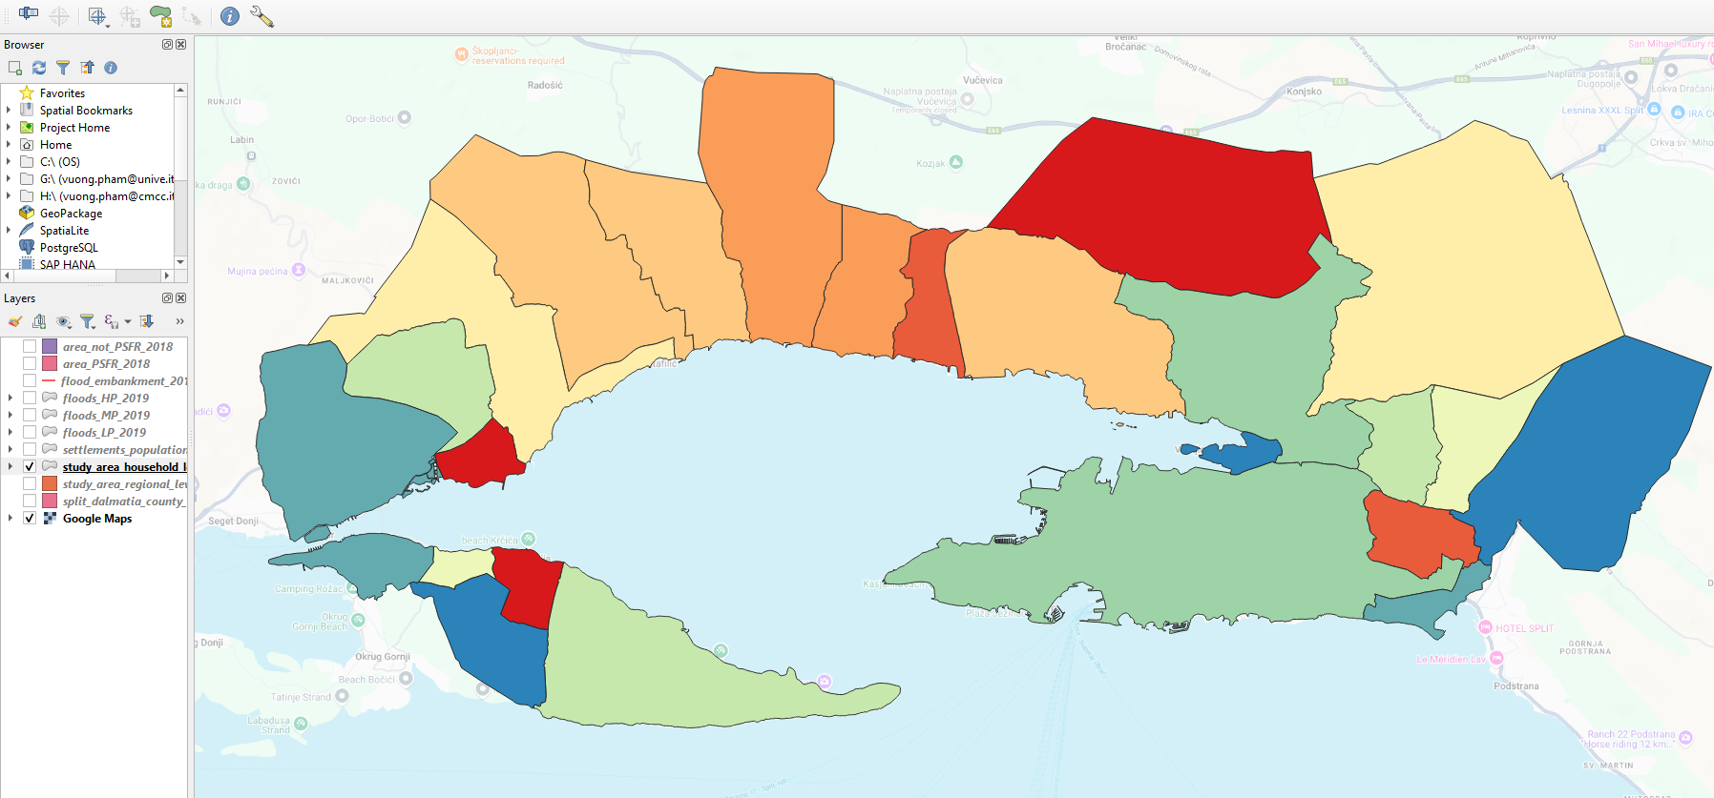
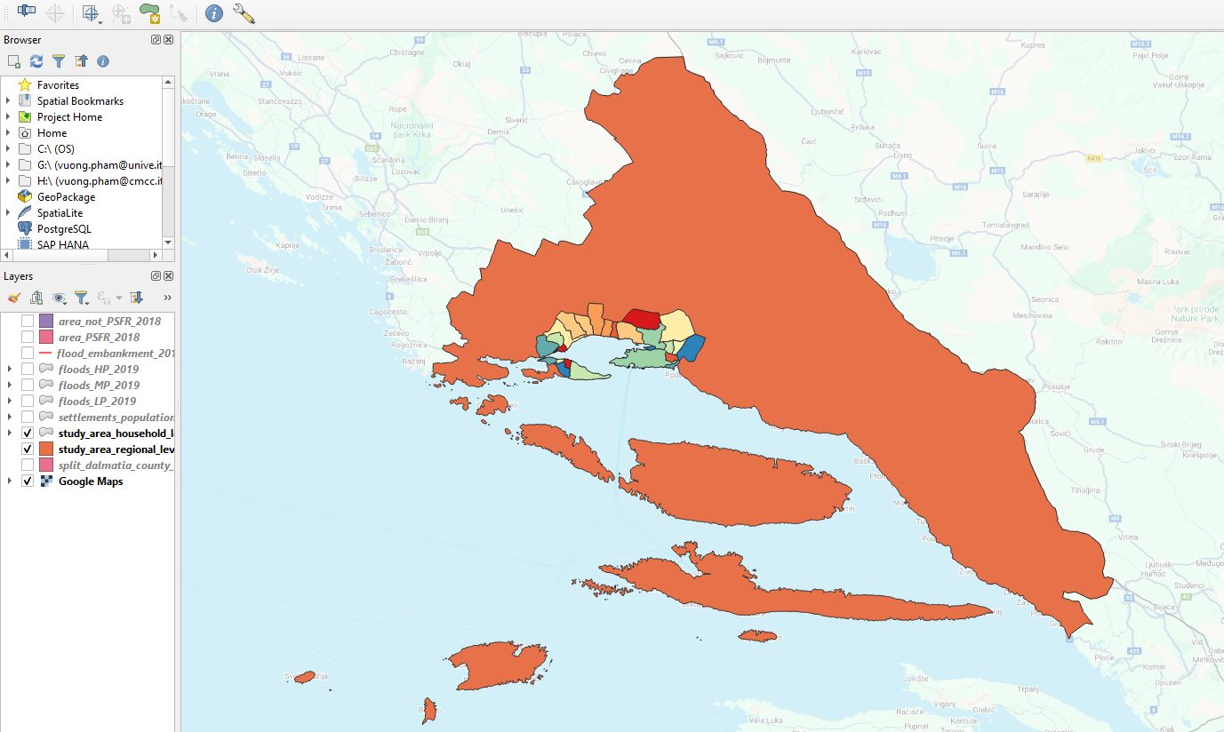
Administrative layers
split_dalmatia_county_border" with the boundary of Split-Dalmatia County
household-level shapefiles

Slide 5
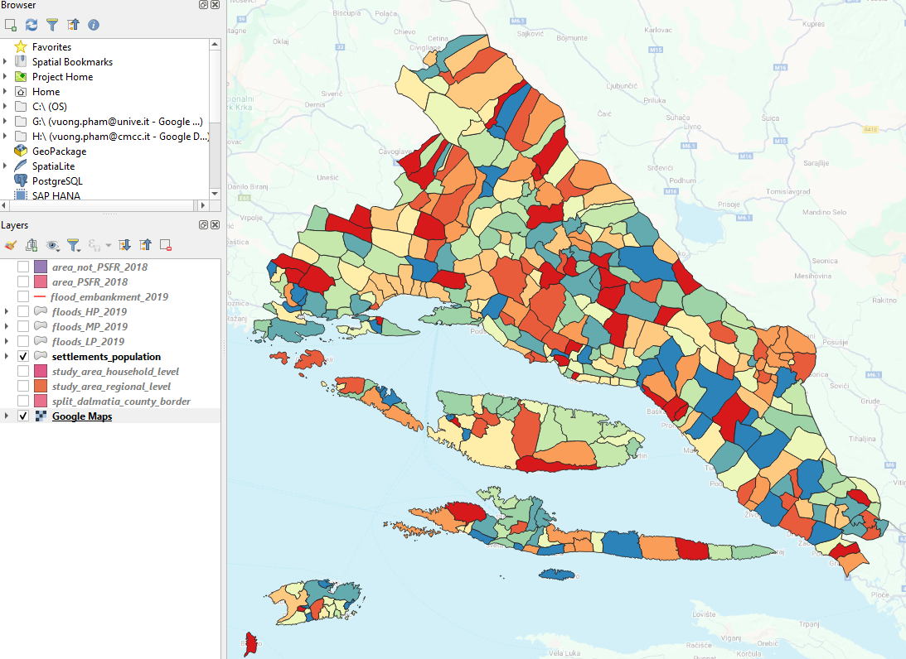
settlements_population
Vector layer "settlements_population" with the boundaries of settlements within Split-Dalmatia County, including population data for each settlement for 2011 and 2021
Maybe 2001 since they report only every 10 years.
@S: Split man and woman.
@D: Other global data might be available: age: 2000 – 2020
=> Coping capacity level.
Notes:
https://github.com/desmond-lartey/BonaireWebMap/tree/Fires/Codes

Slide 6
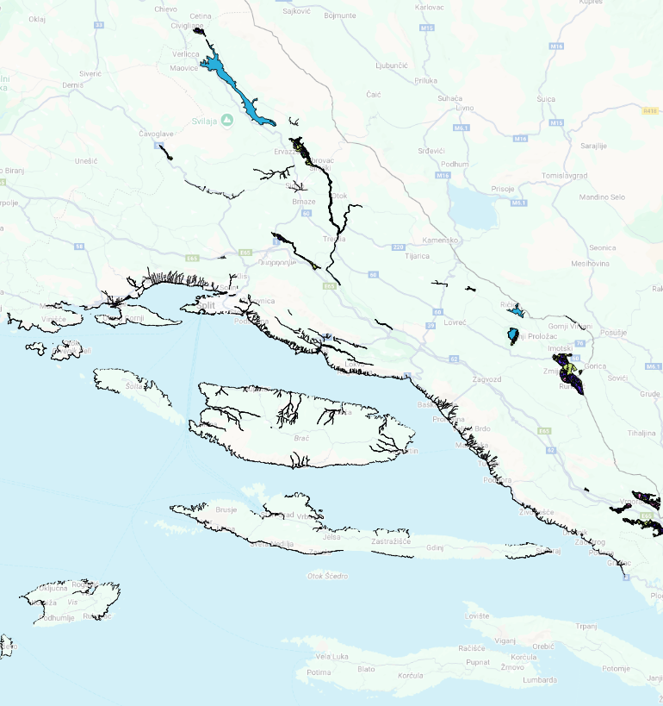
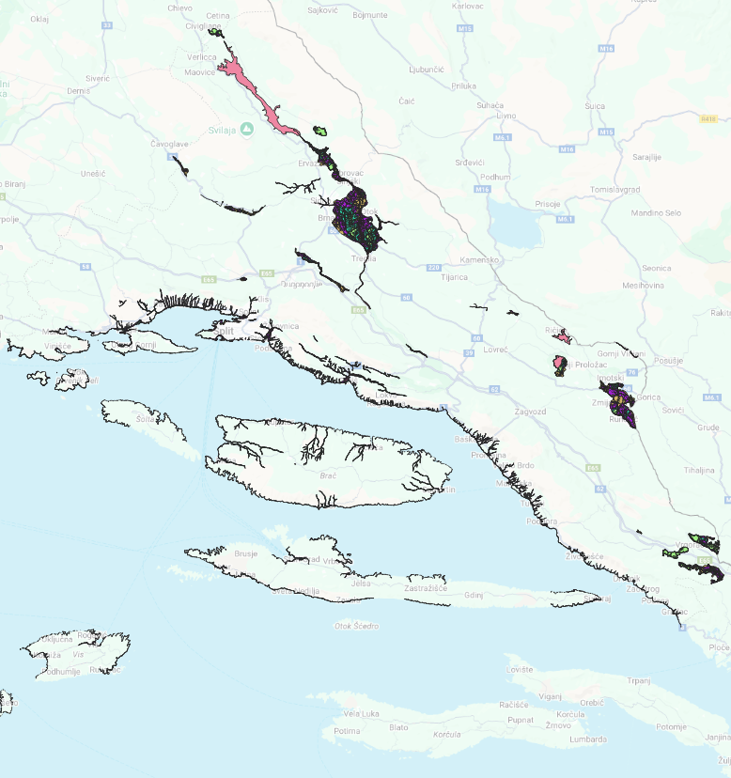
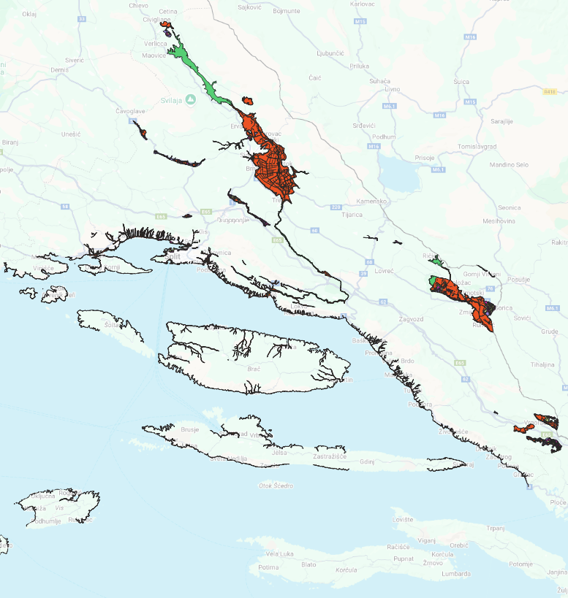
Floods with probabilities of occurrence
Floods with a high/medium/low probability of occurrence (RP = ~25, 100, 1000 years)
Compare with the JRC data. They have several return periods. Uncertainty analysis

Slide 7
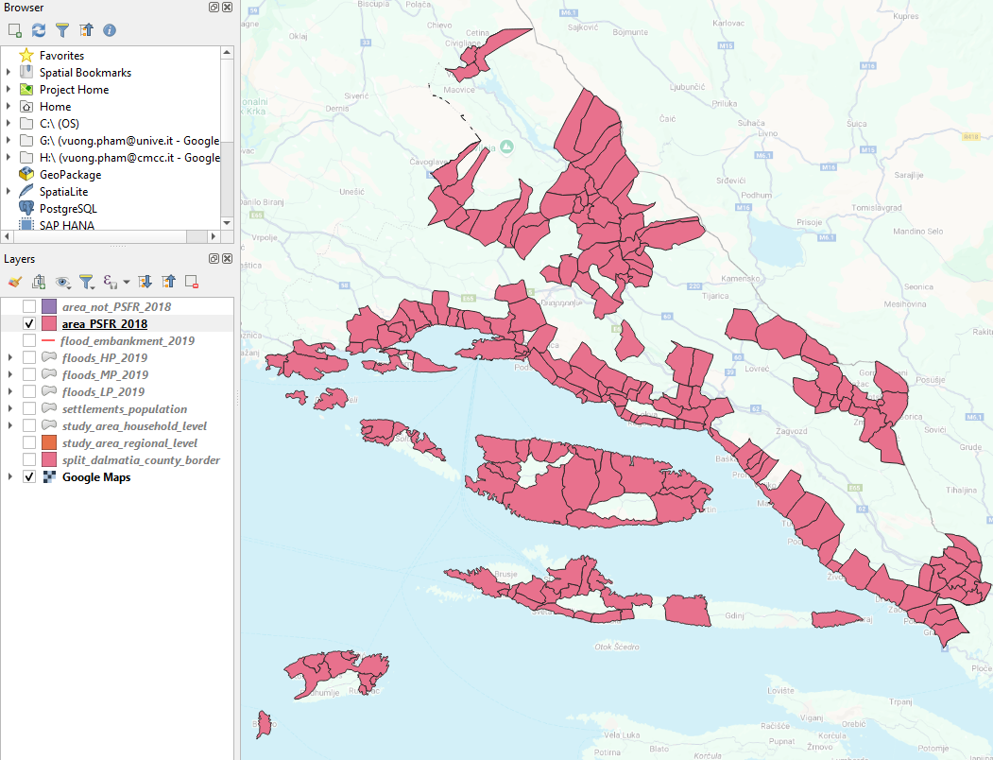
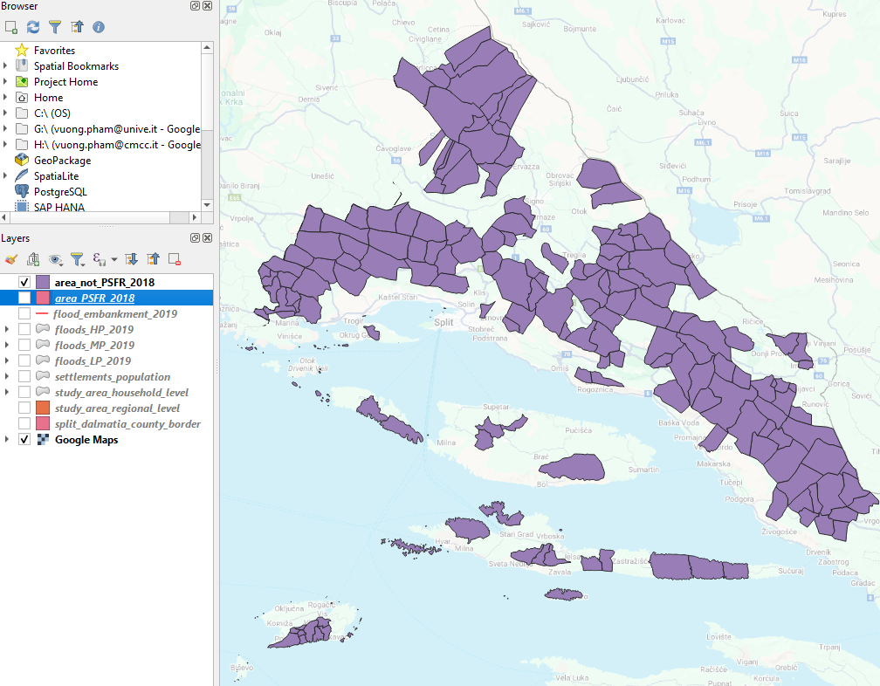
Areas of Potentially (or NOT) Significant Flood Risks
areas that has (NOT) been declared as "Areas of Potentially Significant Flood Risks" by the Preliminary Flood Risk Assessment 2018
@S: check if they have new data, e.g., 2025

Slide 8
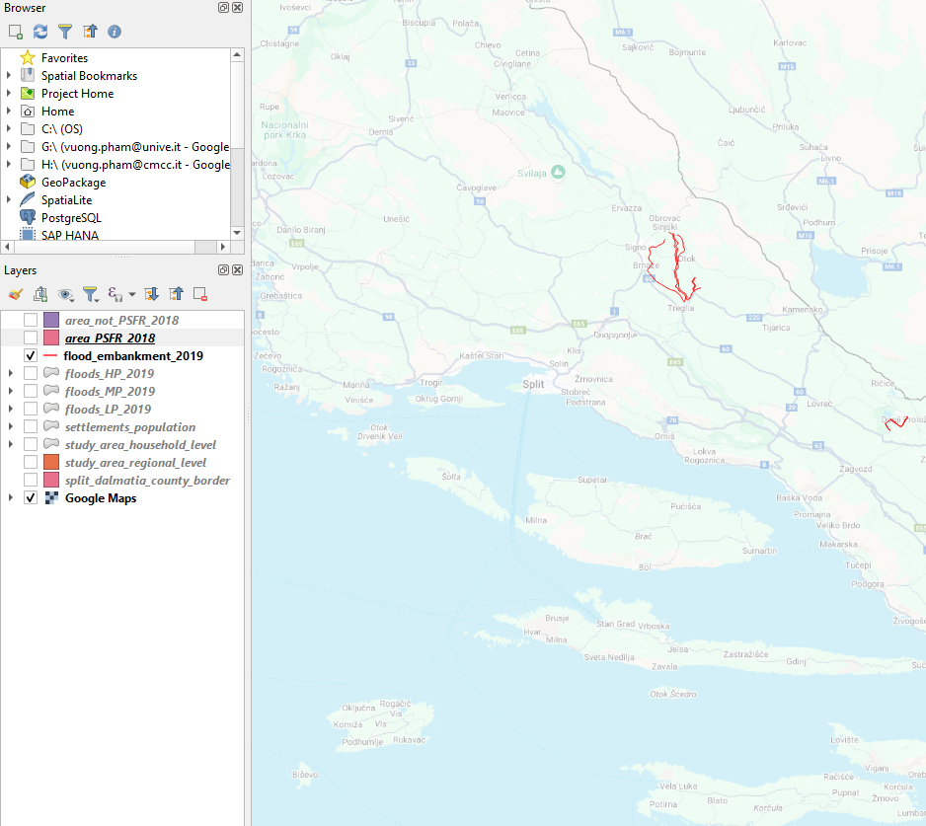
flood_embankment_2019
flood_embankment_2019" - the location of the flood embankment

Slide 9
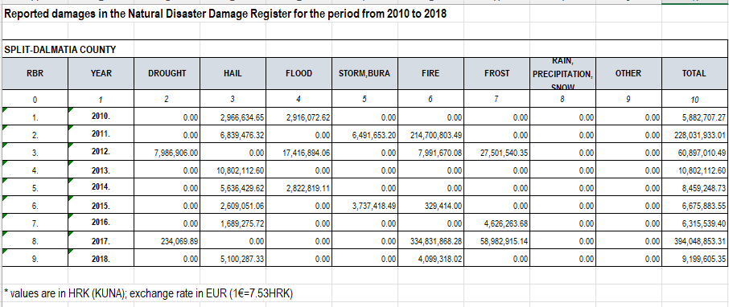
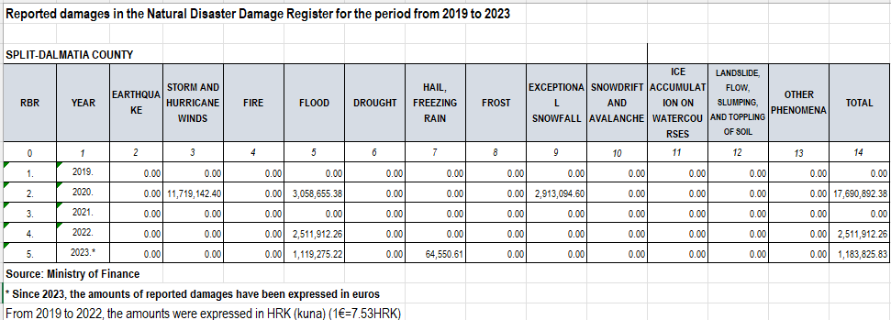
Reported damages
We are sending you Excel tables ("2010.-2018. Reported damages" and "2019.-2023. Reported damages") containing data on reported damages at the county level for the period from 2010 to 2023. For more detailed levels (settlement) of damage data, it is necessary to request the data, which we have done, and we'll send it to you as soon as we receive it
@S: Yearly only.
The finest cale is settlement level only but not building level.
Possible to work at the building level.

Slide 10
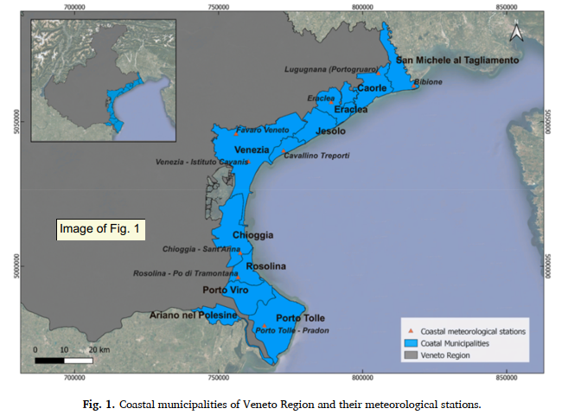
A ML approach to evaluate coastal risks related to extreme weather events in the Veneto region (Italy)
Municipality level

Slide 11
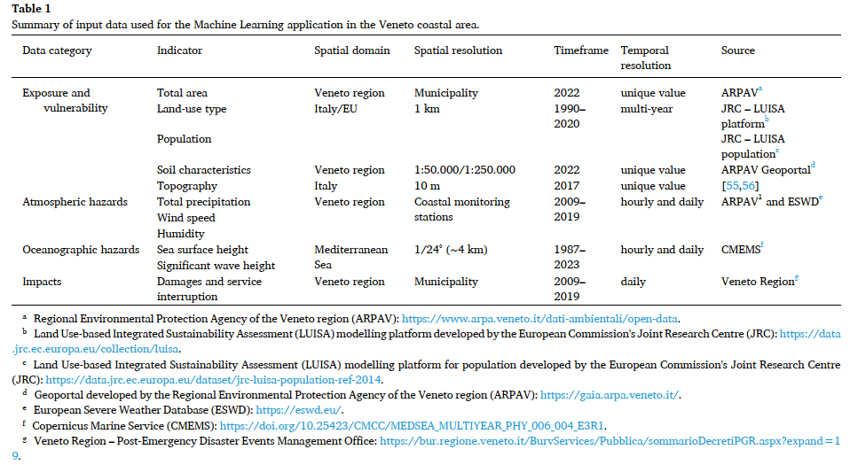
A ML approach to evaluate coastal risks related to extreme weather events in the Veneto region (Italy)
Set of data needed for the assessment
? Do you have this data at a higher spatio resolution in SDC?
=> S: SDC do not have any other local and more detailed data

Slide 12
Progress of landscape achetyes
Task T4.1: landscape achetyes
Updated on 12.12.2024 by Vuong Pham

Slide 13
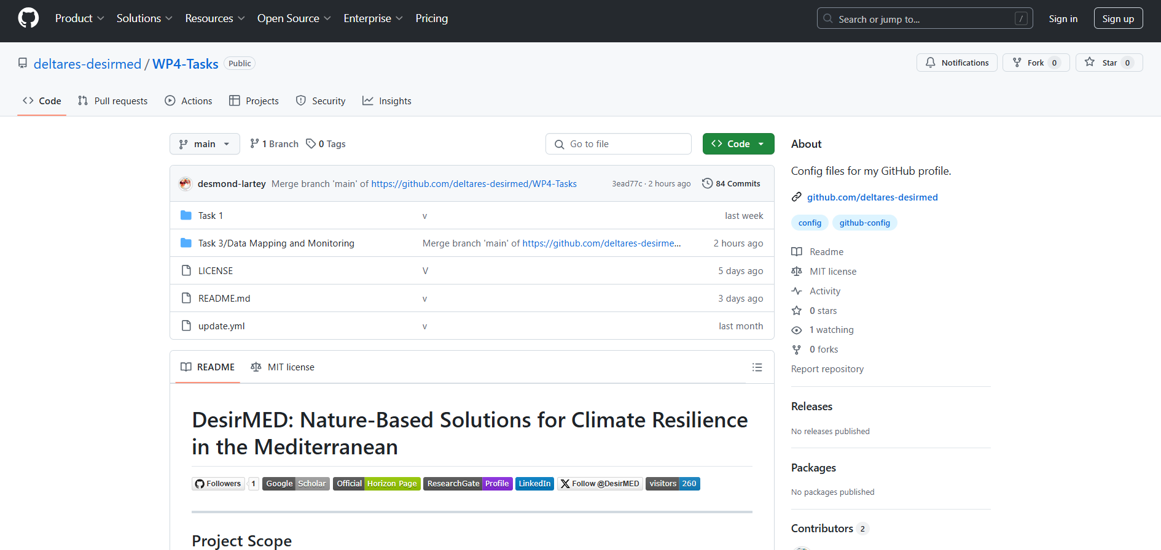
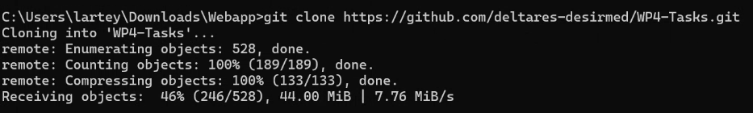
Github platform by Deltares
Some practical guidelines on how to use it?
ReadME:
Report
Make application
Clone

Slide 14
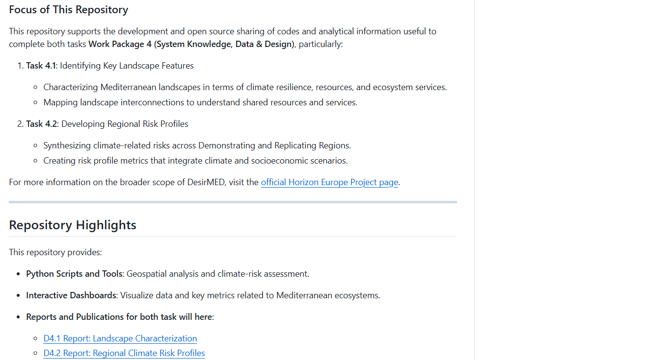
Github platform by Deltares

Slide 15
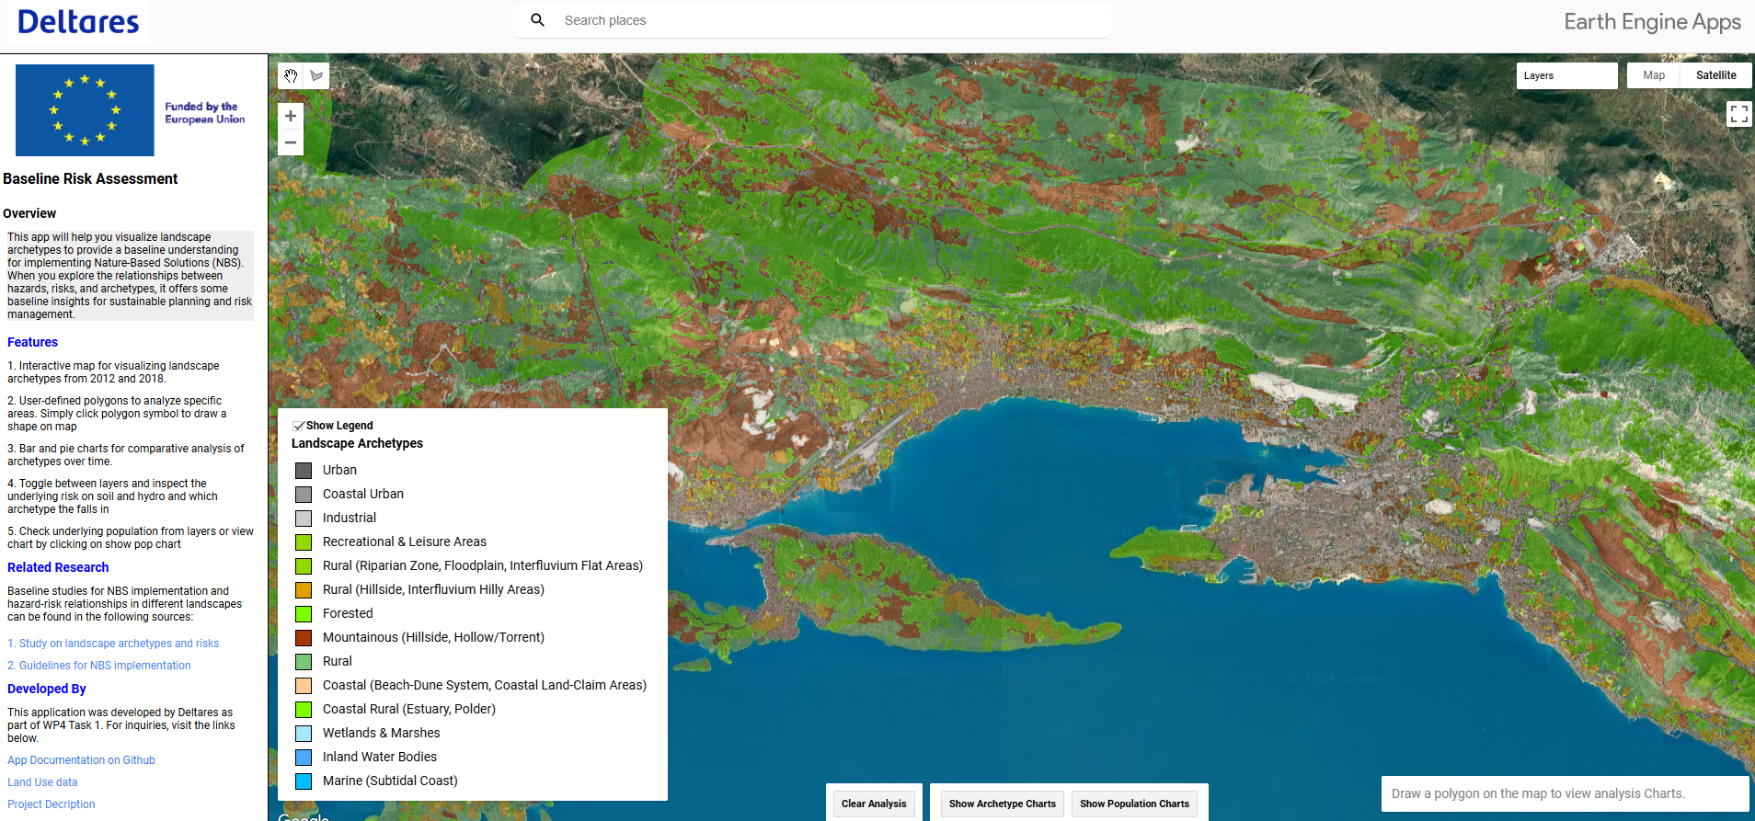
Github platform by Deltares
The look-up table to align from one classification to others => where it comes from?
@D: 71 classes to 14 classes

Slide 16
Note
@D: Grant access to the UNIST team
@D: Upload the metadata on the shared folder so T4.2 can use some of the layers. E.g., governance
@all: Make sure there are not any overlapping with other tasks

Slide 17
Potential collaboration between T4.1 and T4.2
Updated on 12.12.2024 by Vuong Pham

Slide 18
T4.1 and T4.2
Data shared since both tasks have SDC as the Demo case
=> Upload data in the shared folder with metadata, instruction, and presentation (if needed)
Both Deltares and UNIST are developing platforms to store, share, and disseminate the results. Specifically, webGIS (both), GitHub (Deltares), and ArcGIS story map (UNIST).
=> Grant access to frontrunners to edit and update these platforms
Communication: Google Group (Deltares), email loop, frontrunner meetings.
=> Keep frontrunners in the regular track.

Slide 19
Next
@Deltares: The landscape archetype is still not very clear. E.g., how to integrate info on governance, socio-economic
@UNIST: check the progress of the WebGIS and ArcGIS story map; we need the draft to share with all regions. Also, check local and more detailed data on each dimension of risk (i.e., hazard, exposure, and vulnerability). For instance, damage data at the building level, population ages, gender, education level, etc.
@all: we aim to have the draft of both tasks for the SDC (i.e., landscape archetype, multi-risk assessment, webGIS and ArcGIS story map) then disseminate the results with all regions. We also share working pathways, technical documentation, and tutorials. If DRs and RRs want to make the same application, we can provide support,
@all: Make sure there are not any overlaps with other tasks

